Slide 1
Text Processing for Econ Research
February 18, 2025
Notes:
Welcome. We are so happy you’re here.
It is an exciting time. You have a big decision before you. One of your considerations should be: Where is my research likely to thrive?

Slide 2
Introduction
Kellogg Research Support
Text Processing: What kind of things can you do?
Text Processing Techniques
Representing Text/Words
Large Language Models (LLMs)

Slide 3
Kellogg Research Support

Slide 4
Kellogg’s Research Support Team
Our team’s mission
Provide solutions that give Kellogg faculty & students
a competitive advantage in their research.
Resources & services to overcome obstacles across the research life cycle
Obtaining Data
Preparing Data
Analyzing Data
Sharing Results
http://www.kellogg.northwestern.edu/research-support
Notes:
Allow me to introduce myself and my team.
Kellogg has made a significant investment in resources to enable research.
This includes tools as well as people.
Let me describe these tools and these people for you.

Slide 5

Computing Environments for Any Problem
Kellogg Linux Cluster
568 CPU cores
600 TB project storage
20 TB RAM
Kellogg Data Cloud
For large datasets
KAP03
For a secure Windows environment
Northwestern Quest
If you need large amounts of CPU…
HPC cluster with > 60,000 CPU cores
http://www.kellogg.northwestern.edu/research-support/computing
Notes:
JOHN
Kellogg has a wealth of computational resources and services at your disposal, supporting pretty much any need you have. Our work-horse computing environment is the Kellogg Linux Cluster (KLC) that gives you the power to run big jobs that require large resources (like memory, compute power, and storage) . In most situations, KLC will help you get your job done.
But, what if your situation calls for something different? <CLICK>
Kellogg also provides a variety of other environments (listed here). Most recently, we've made great strides in adopting cloud resources, like Amazon Web Services, to optimize our researchers' work. For instance, AWS Athena helps our researchers query terabyte scale databases in a fraction of the time compared to traditional SQL servers.

Slide 6



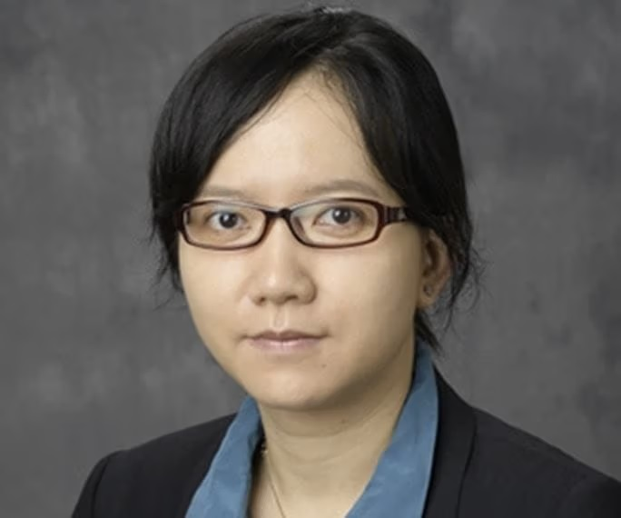
Plus: Experts to Help You Use Them
Computational Research Consultants recommend solutions to your problems…
Write sophisticated programs
API integrations
Extract information from text or images
Make jobs run faster, crash less
Automate manual processes
Secure your data
Review your code for replicability
http://www.kellogg.northwestern.edu/research-support/services
Notes:
WILL
Kellogg has also invested in a team of computational consultants who are all here to help you. We can guide you on how to best use our computing ecosystem and give advice on computing tools for your research.
Each of us consultants have PhDs in quantitative fields and together we have a LOT of advanced programming experience to guide you through some of the tasks listed here like automating your computing jobs on our server through bash scripting or making your programs run faster with parallel processing.
We’ve all done computational research similar to what you will undertake and understand the challenges you face. Academic research can sometimes be inherently isolating and we want to emphasize that here at Kellogg you will not be alone. There is literally a team of people who can help you figure out why that piece of code you've painstakingly spent weeks writing just won’t run on the server.

Slide 7
Text Processing / NLP

Slide 8
Why Worry about Text Processing?
Much of human knowledge is encoded as text
The Internet
Economics Data in particular
Data in General
Your professional life is filled with text in different forms
Manuscripts
Code
Email correspondence

Slide 9
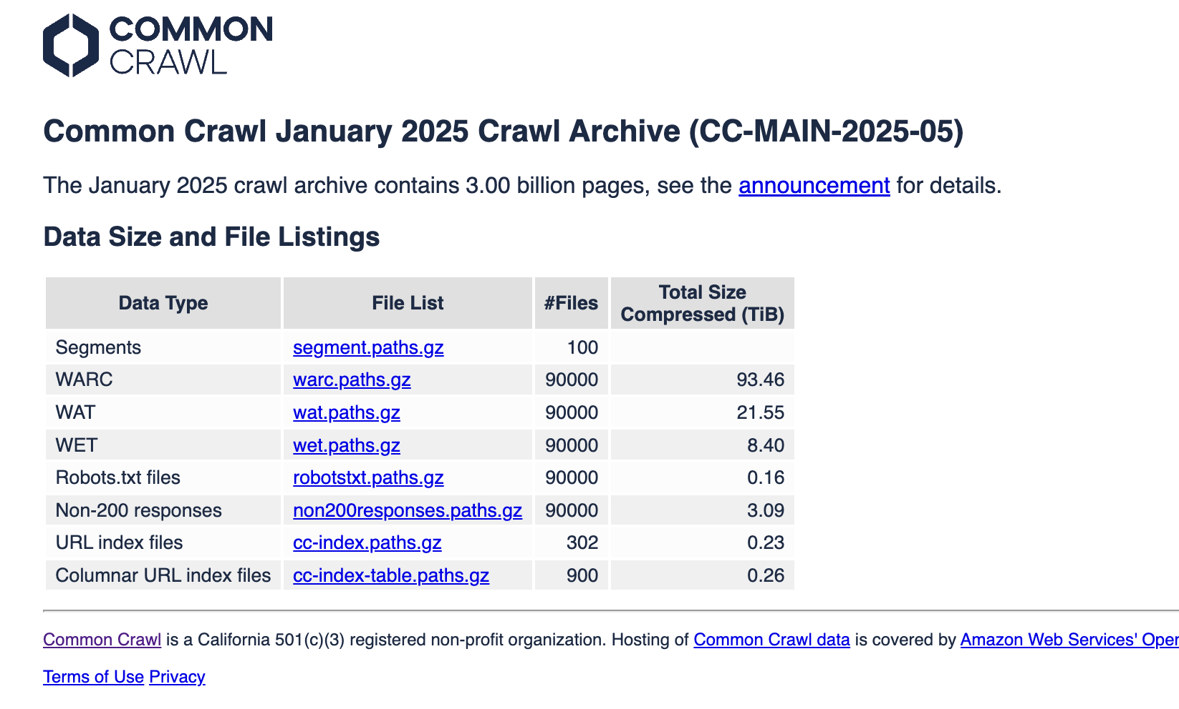
Common Crawl

Slide 10
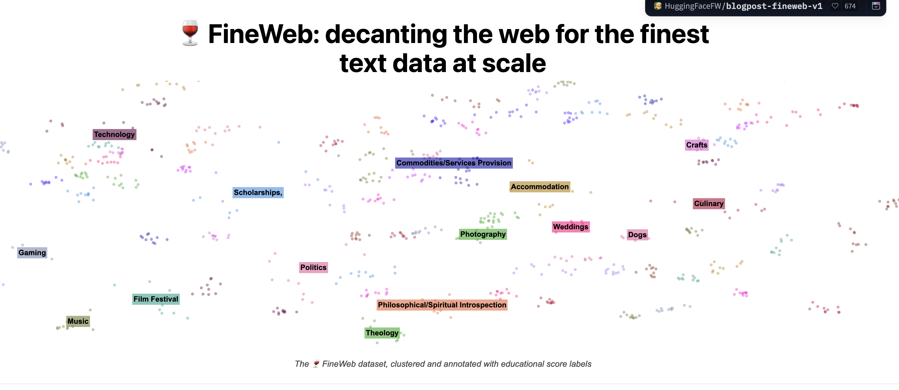
FineWeb

Slide 11
Traditional NLP Tasks
These tasks have all been studied for decades within the NLP community:
Document classification (spam vs. ham)
Sentiment analysis (product reviews)
Document summarization
Document clustering / topic detection
Information extraction
Translation
Question Answering

Slide 12
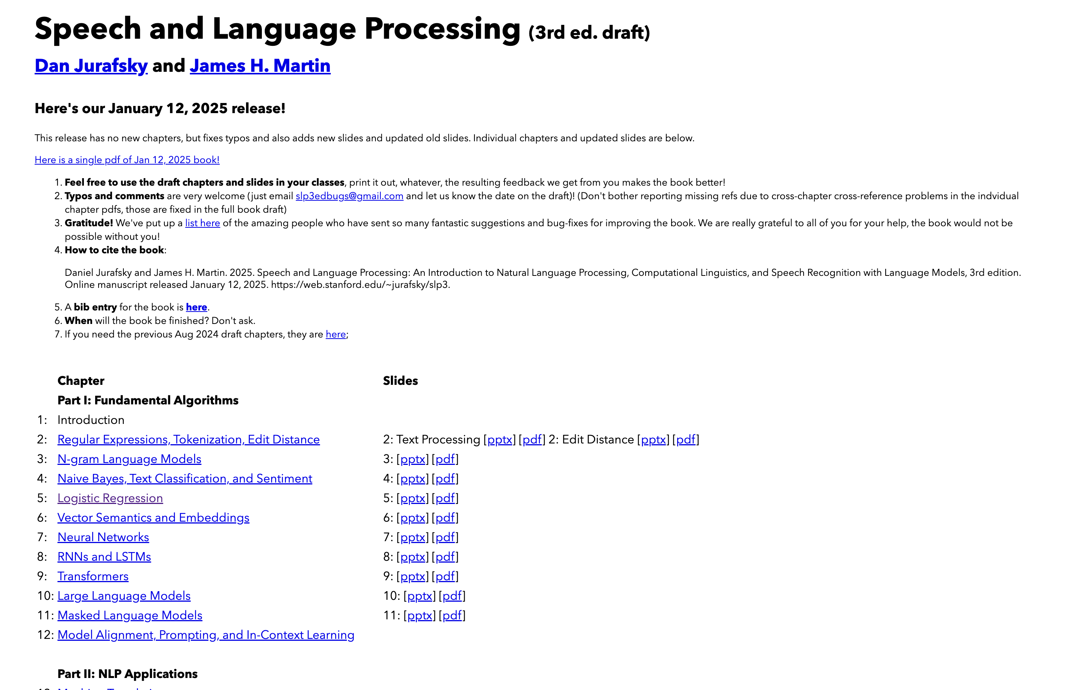
Traditional NLP Tasks
https://web.stanford.edu/~jurafsky/slp3/

Slide 13

Sentiment Analysis

Slide 14

Document Classification

Slide 15
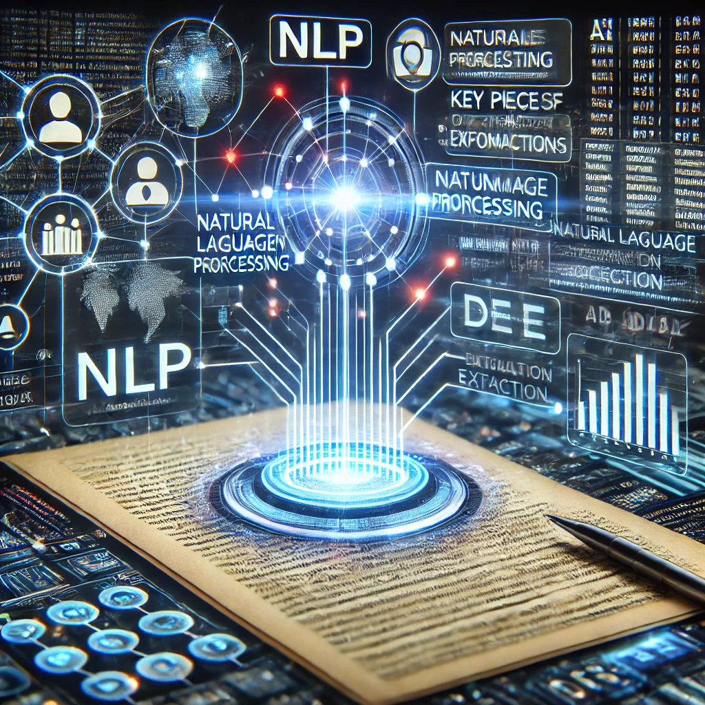
Information Extraction

Slide 16
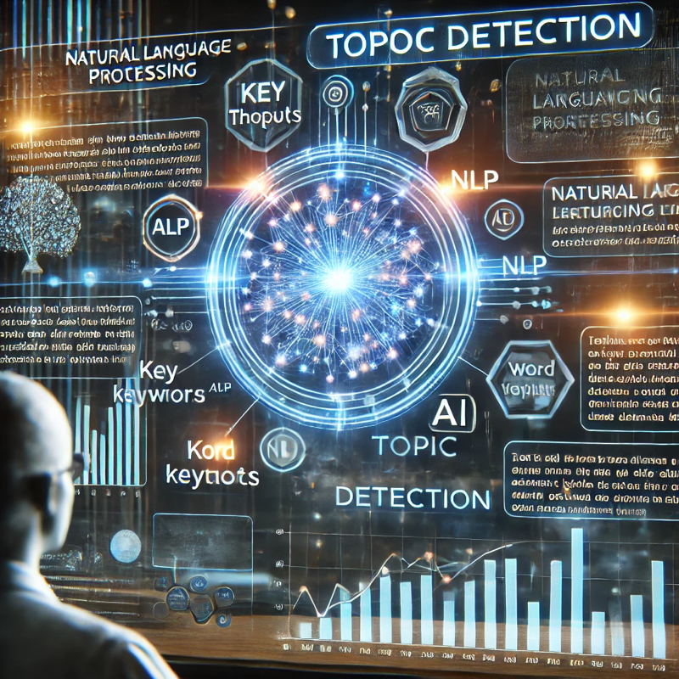
Topic Detection

Slide 17
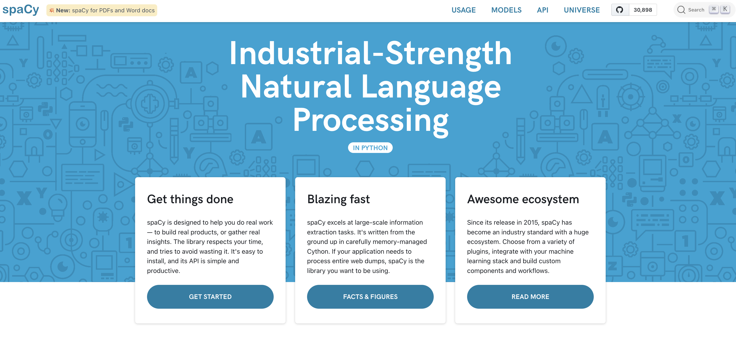
Traditional NLP Tasks
https://spacy.io/

Slide 18
Representing Text: Words

Slide 19
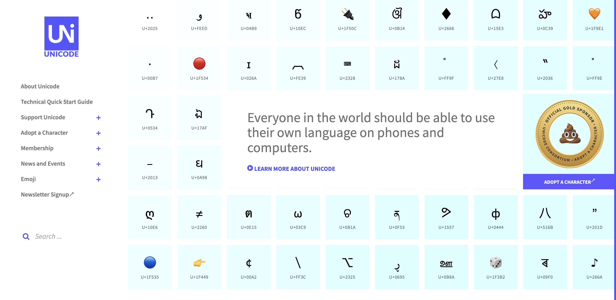
Computational Representation
At the lowest level, text is a 1D array of numbers
https://home.unicode.org/

Slide 20
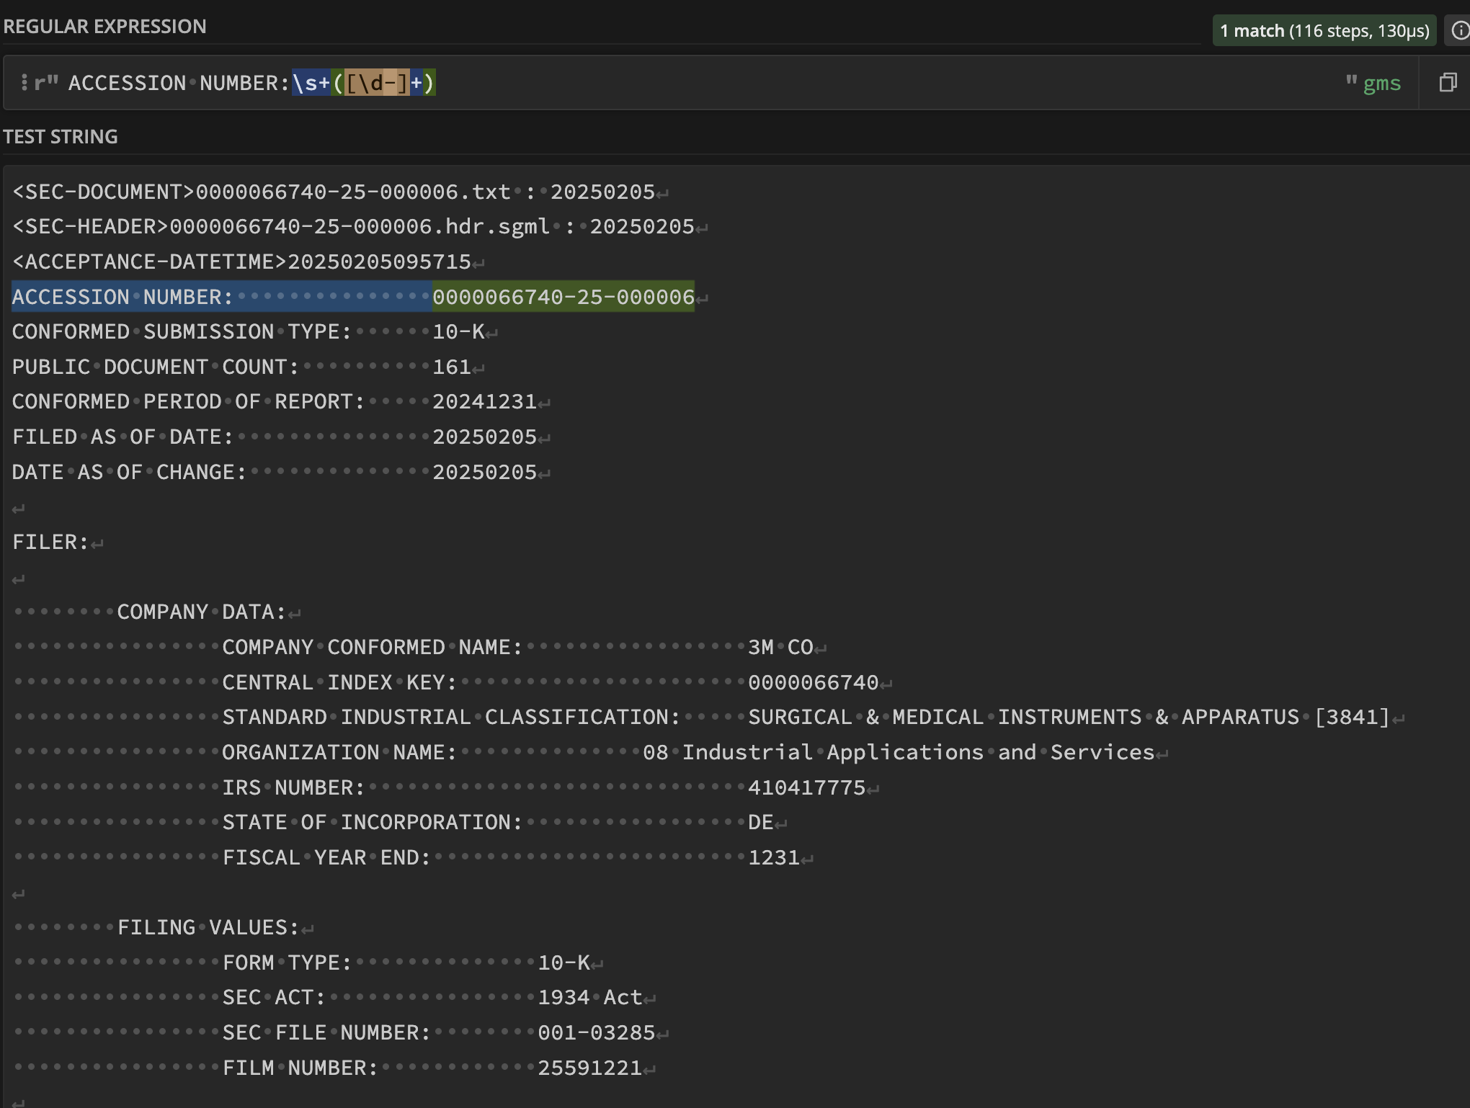
Regular Expressions

Slide 21
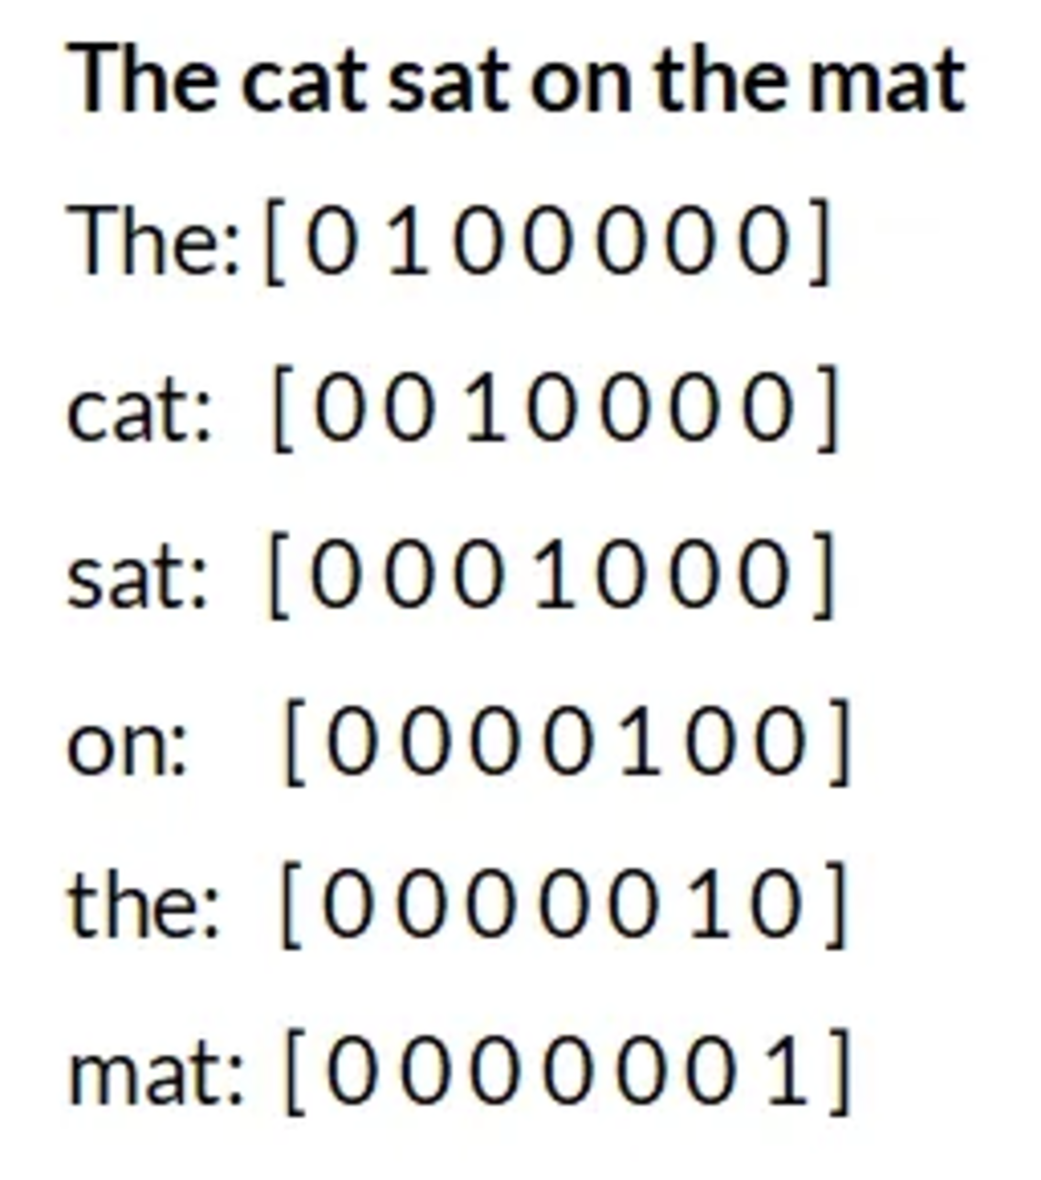
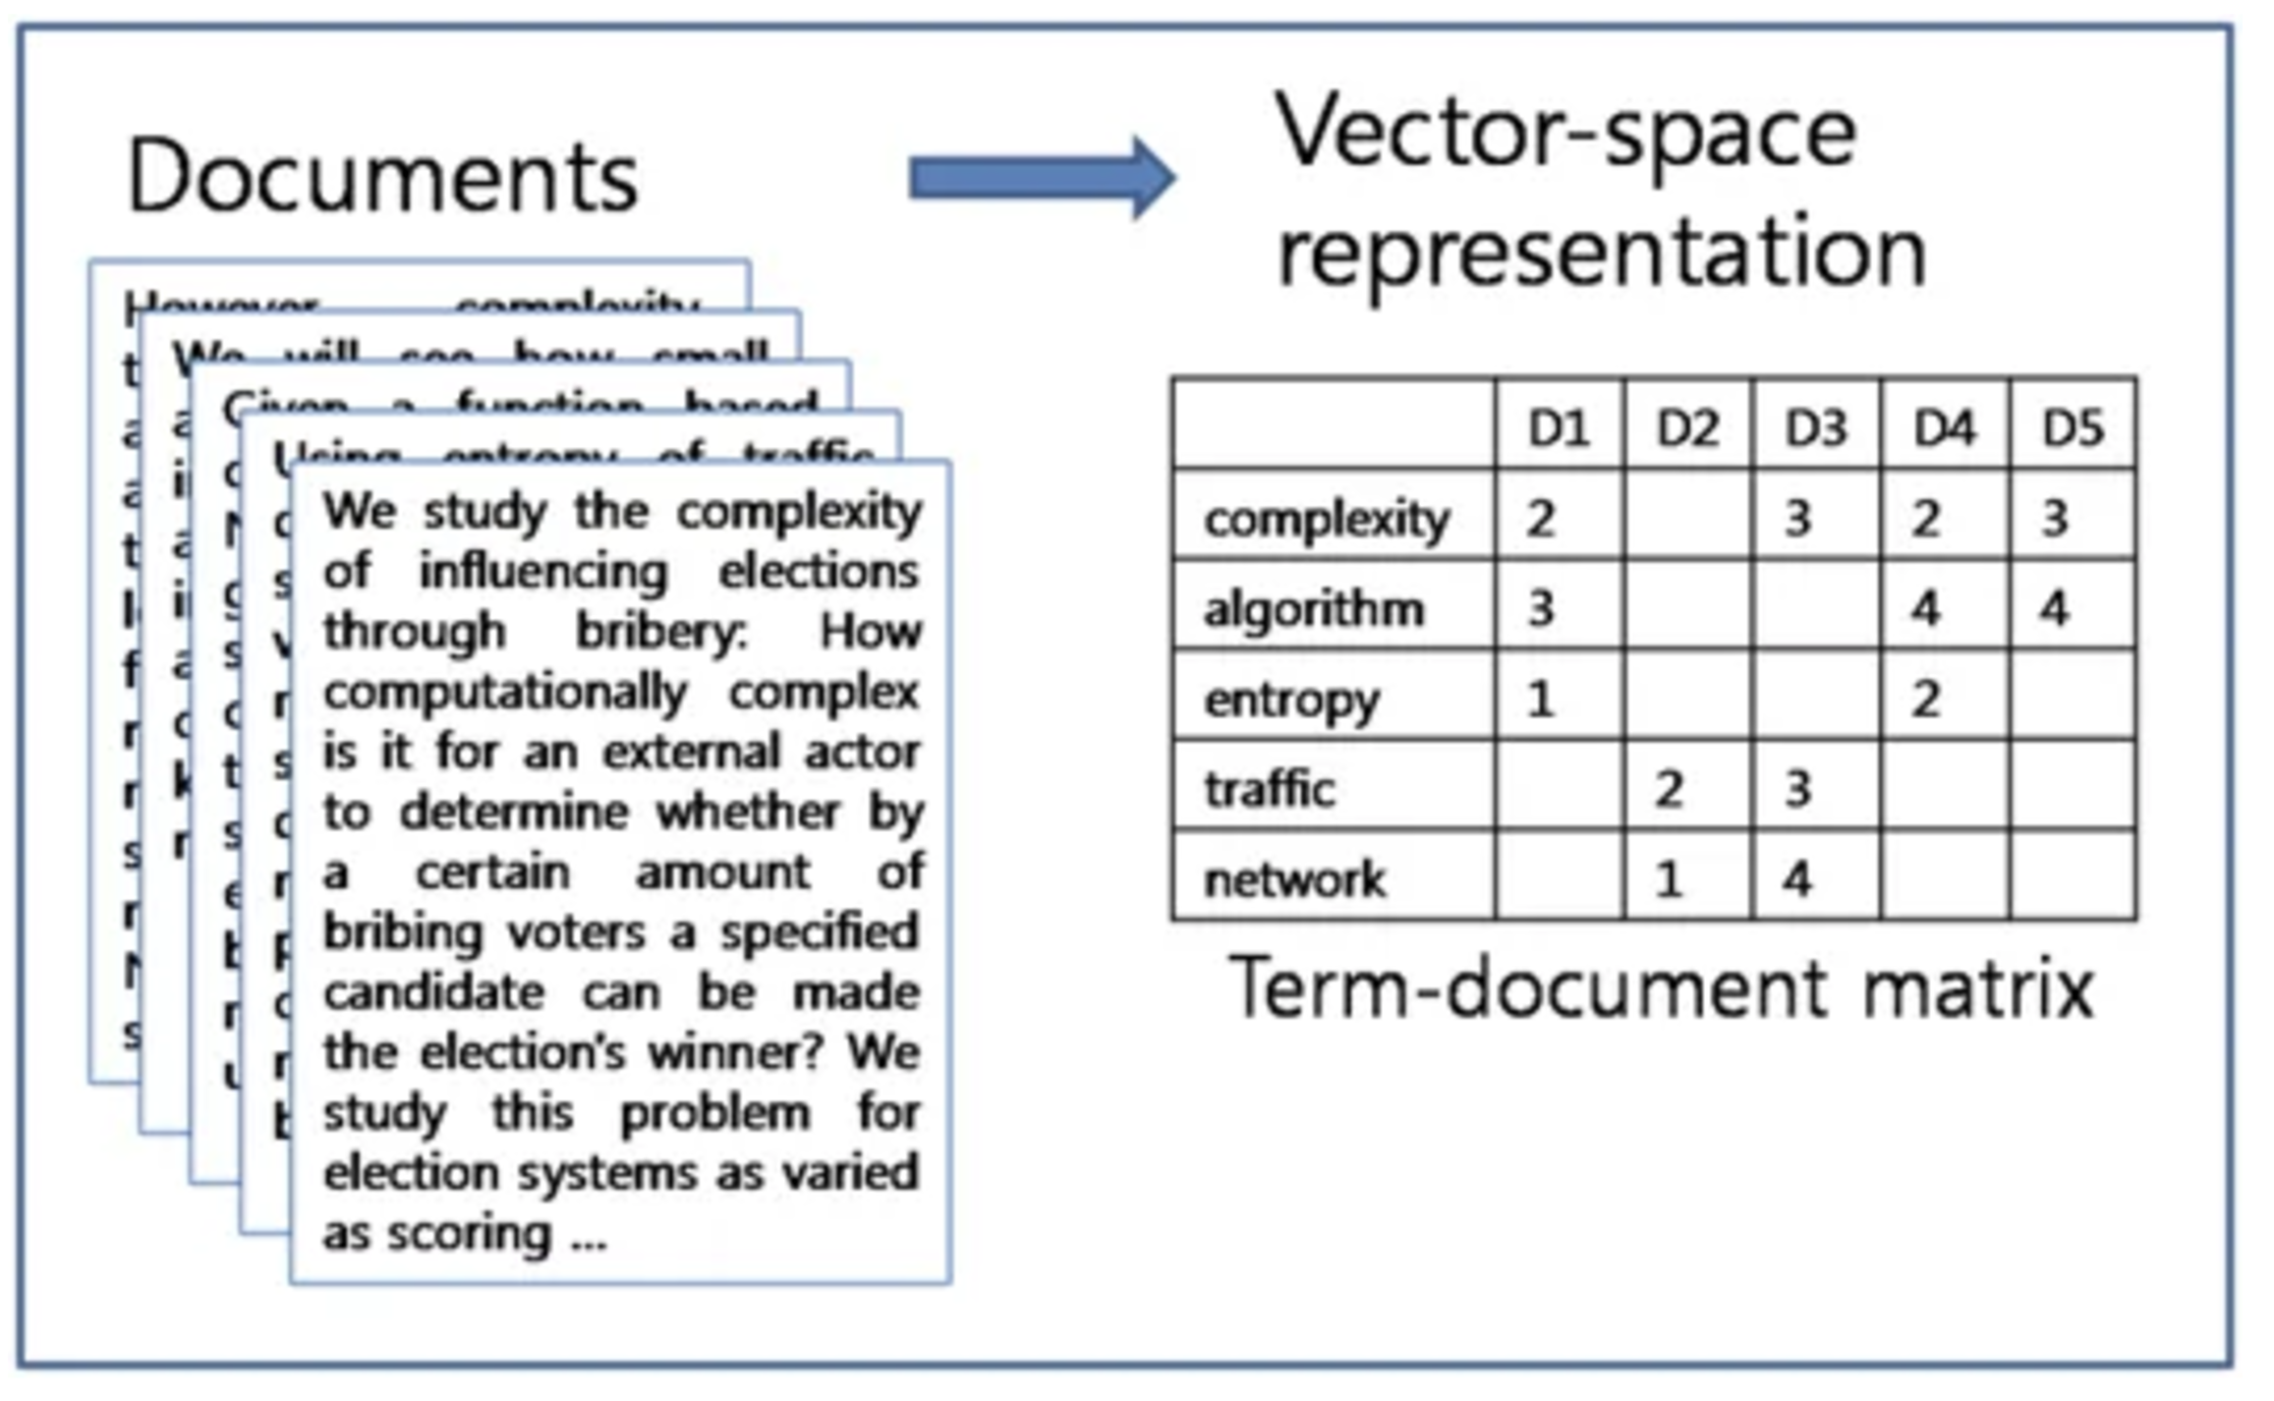
Bag of Words
Sparse, 1-hot encodings
No natural notion of word similarity
Term Document Matrices
TF-IDF weightings

Slide 22
Vector Space Models
First neural embeddings: word2vec and glove
Improved NLP tasks across the board
Now there was a proper way to calculate similarity between words: e.g., cosine of angle
Contextual word embeddings
Words take on vastly different meanings depending on context (e.g., ”bank”, “don’t love this movie”)
BERT, LLMs
Vector embedding databases
https://platform.openai.com/docs/guides/embeddings
https://huggingface.co/docs/transformers/en/model_doc/bert

Slide 23
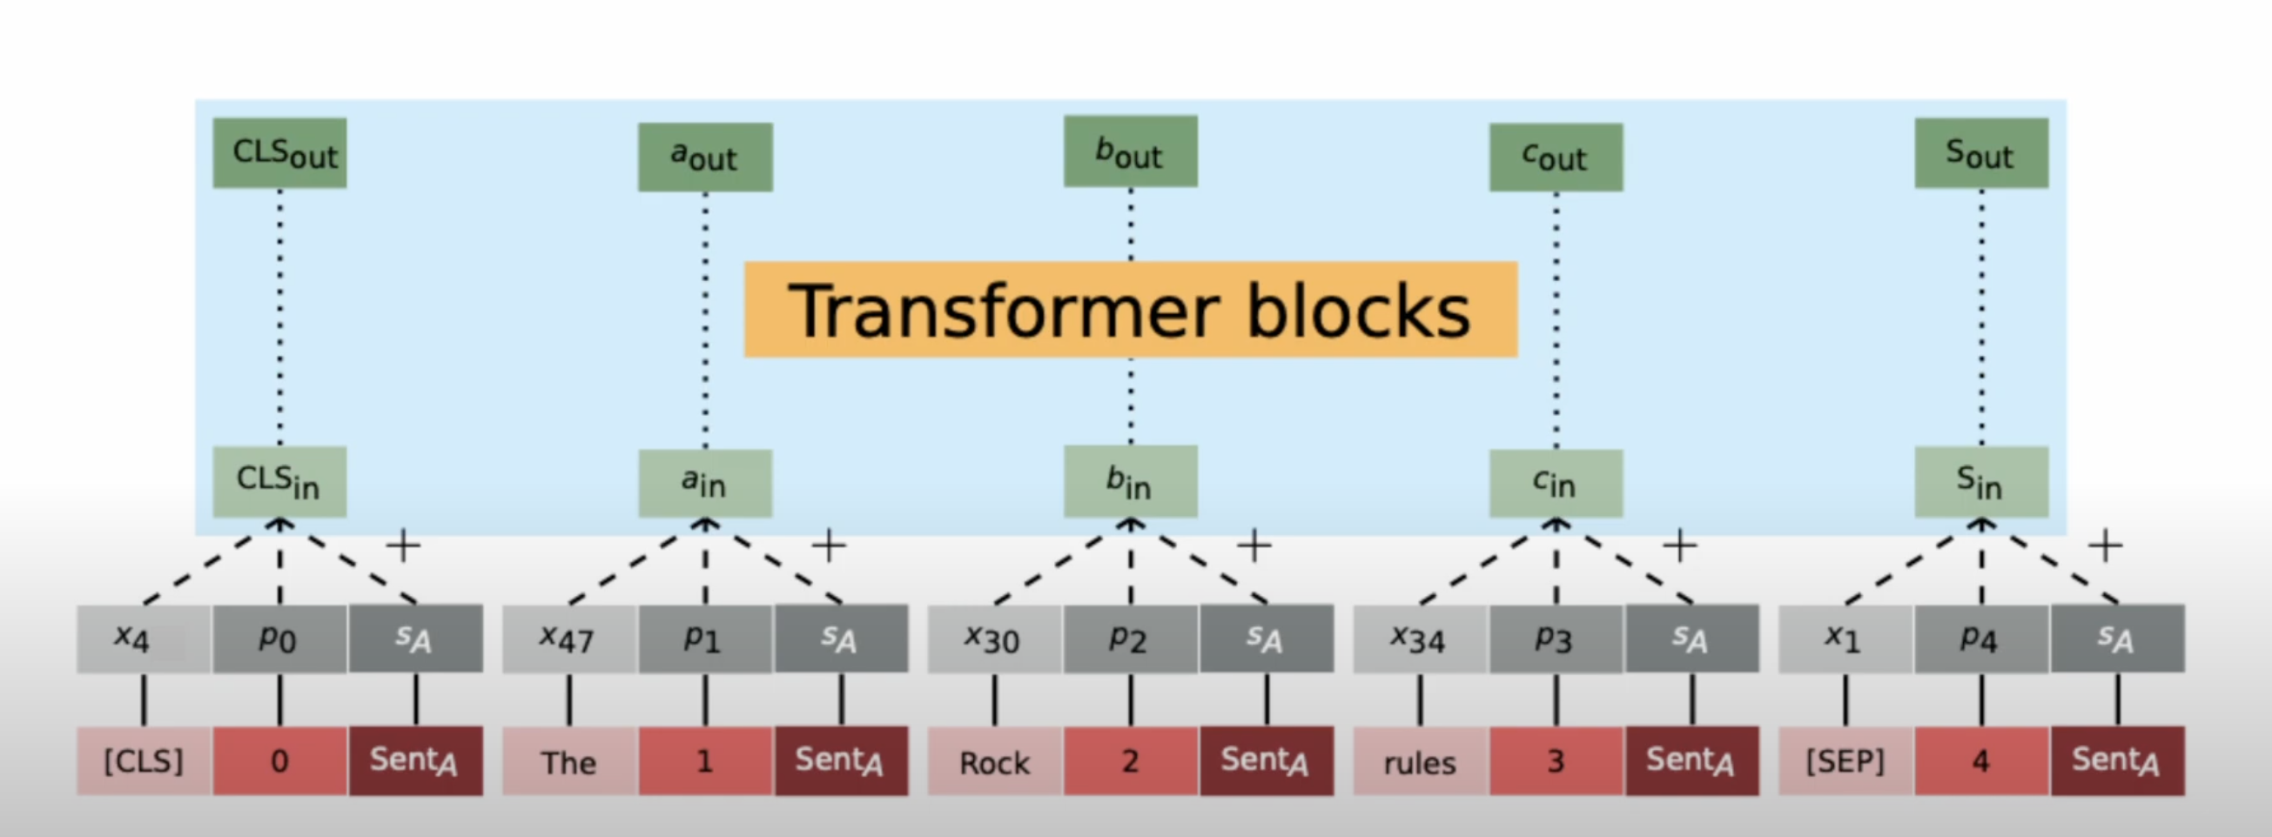
Contextual Word Representations

Slide 24
Generative AI: Large Language Models

Slide 25
Generative AI – Large Language Models
LLMs can do traditional NLP tasks, sometimes with much less effort, sometimes with much better performance than traditional techniques.
Plus:
Literature surveys
Generating first drafts
Analyzing and generating text in general
Analyzing and generating code (structured text)
Agentic workflows
Simulating people

Slide 26

LLMs as Text Generators

Slide 27
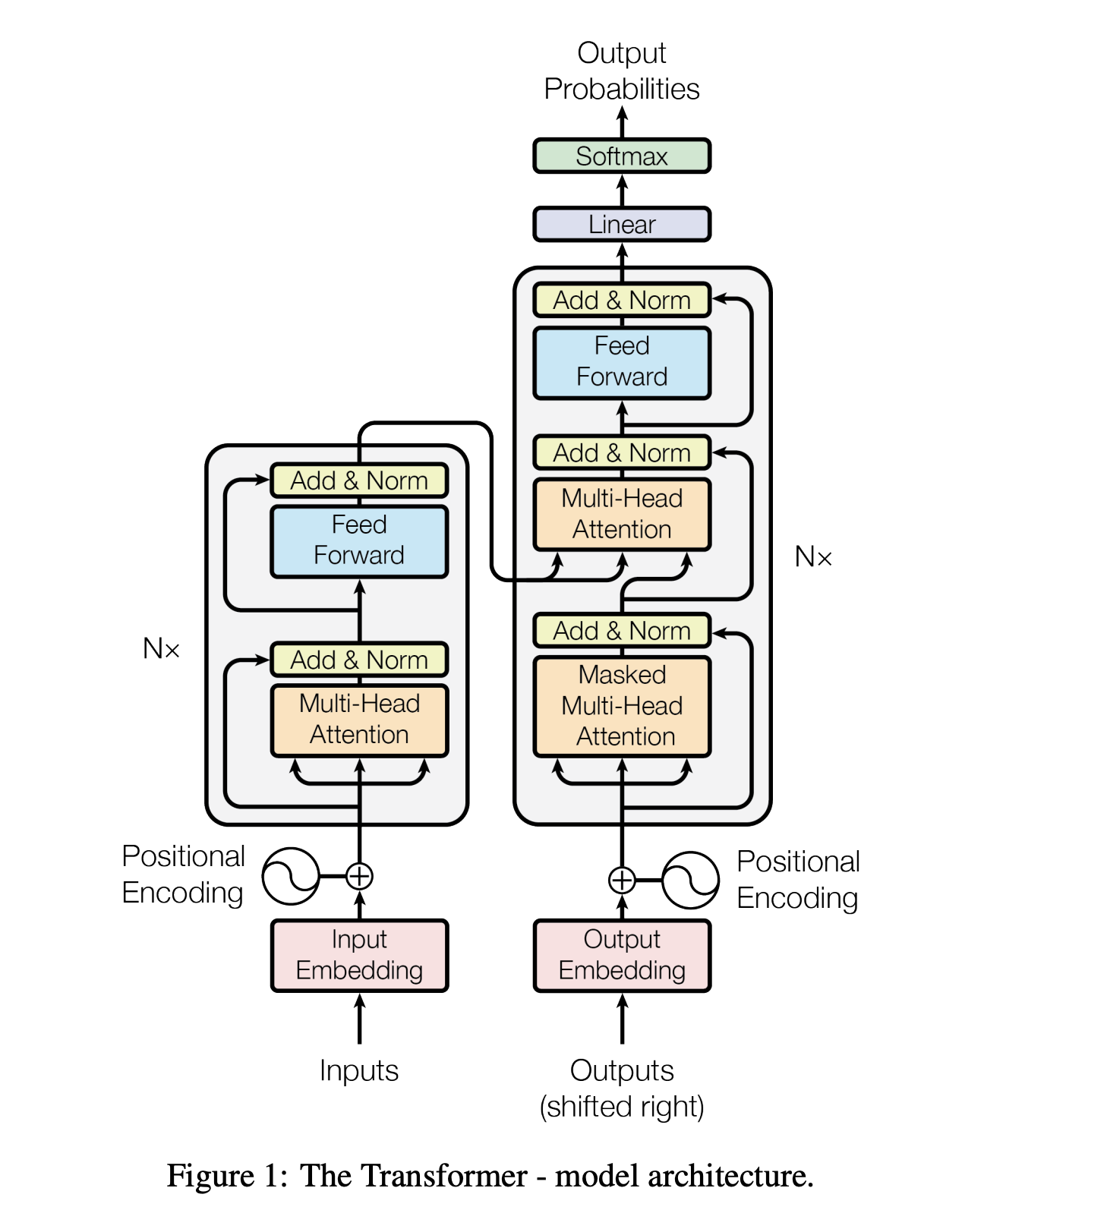
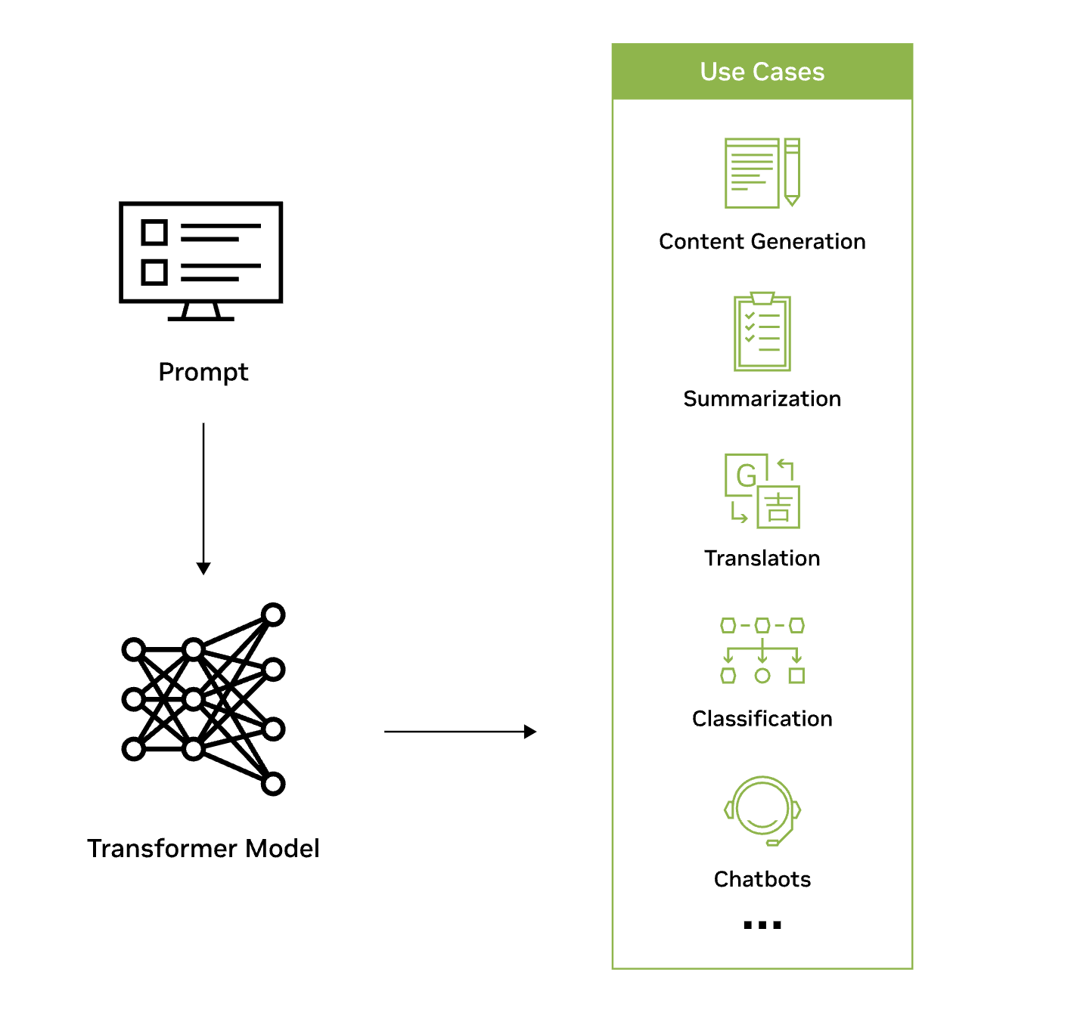
(Large) Language Models
https://bbycroft.net/llm

Slide 28
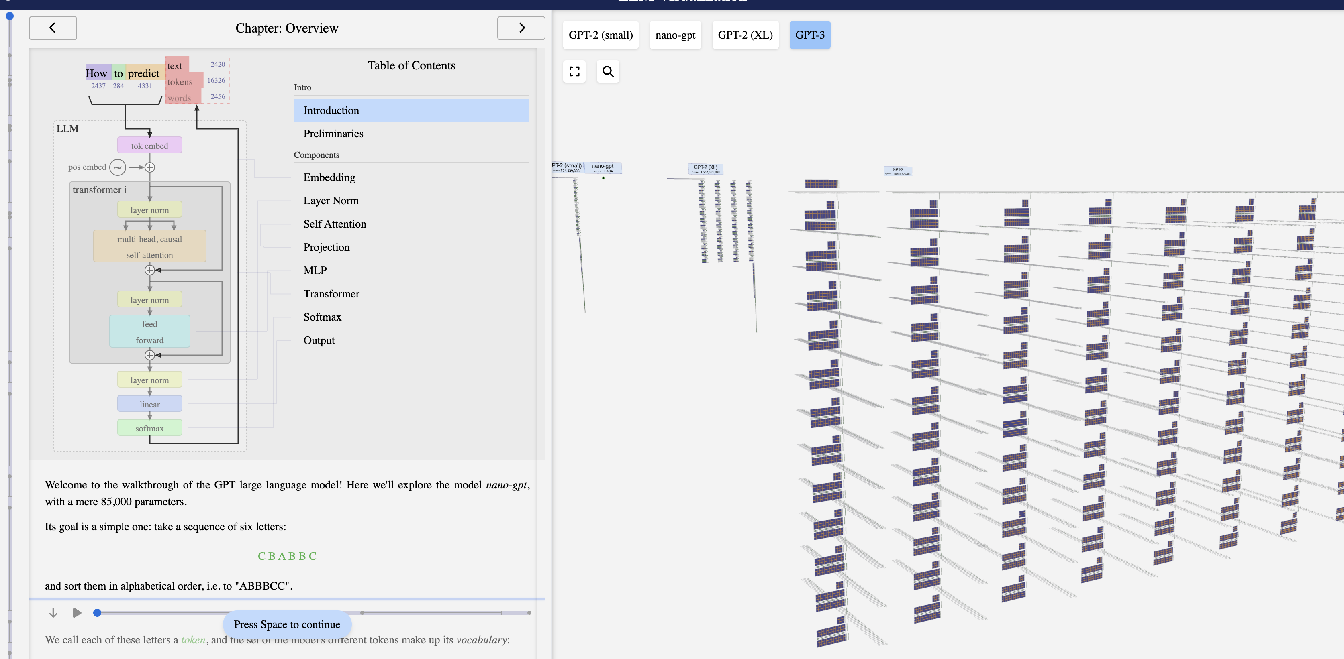
LLM Architecture

Slide 29
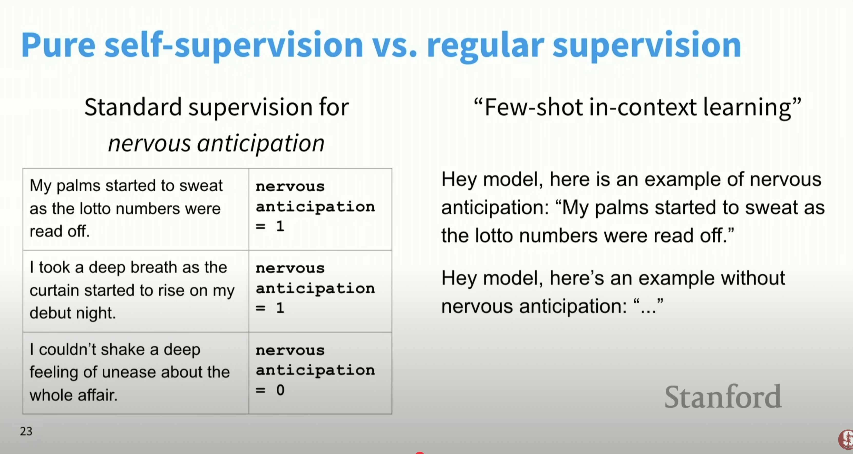
Traditional ML ➡️ LLM Approach

Slide 30
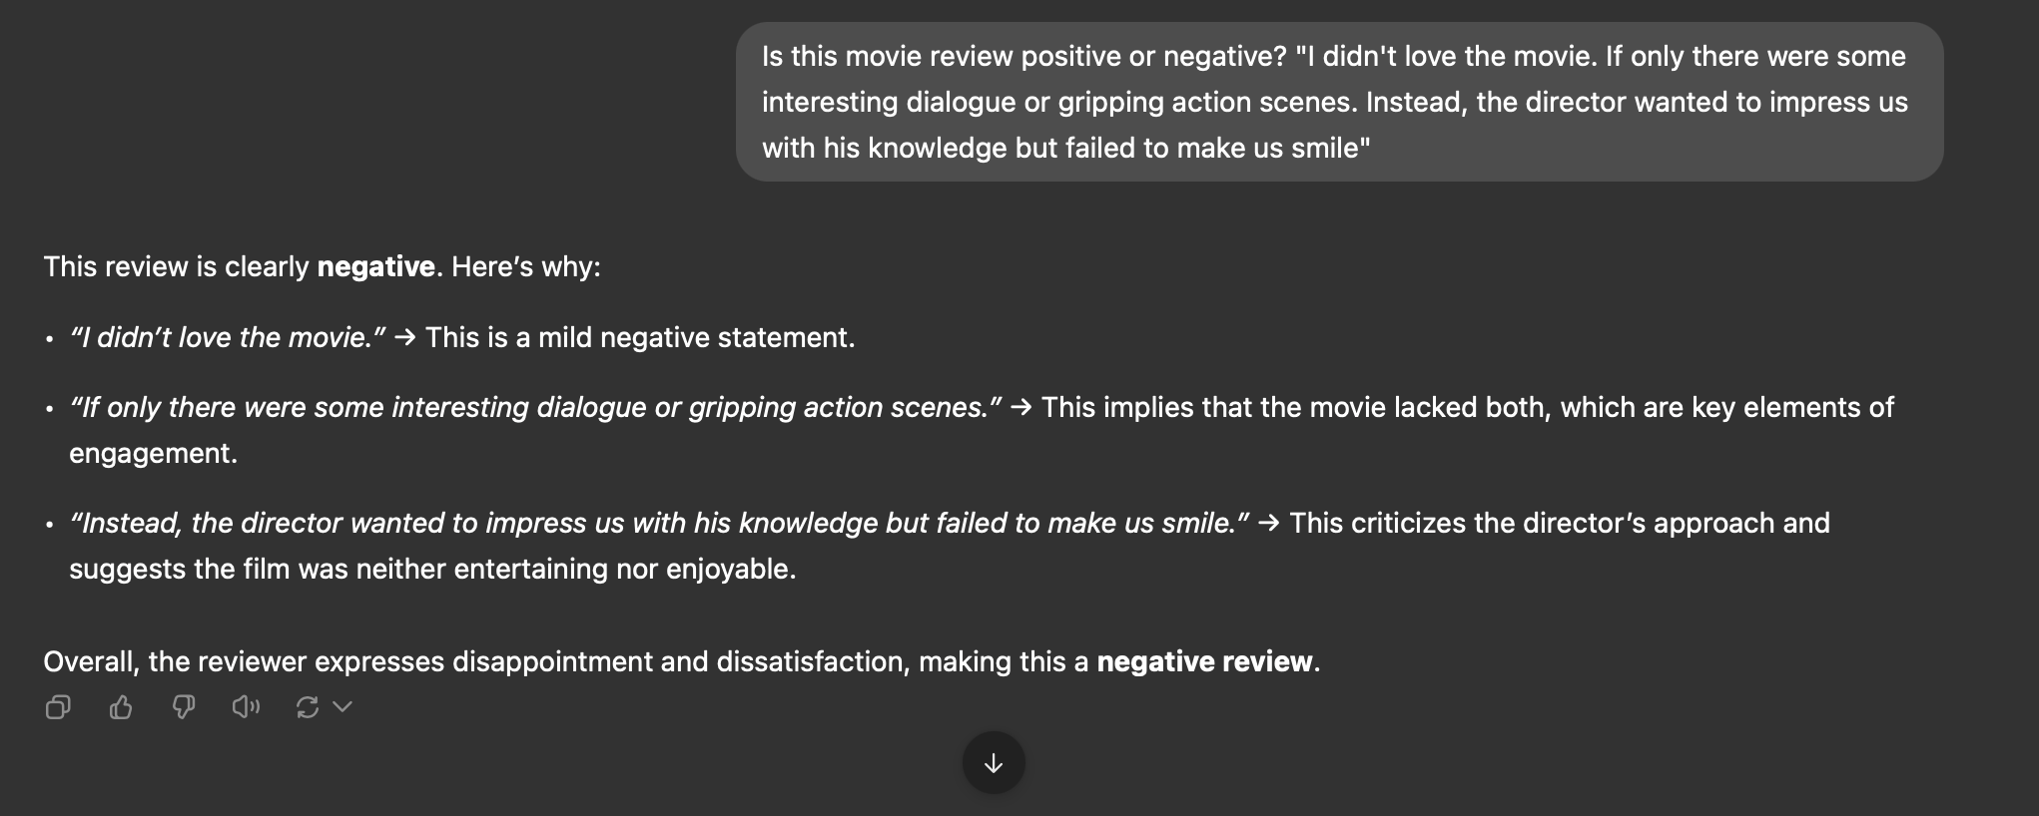
Example: Sentiment Analysis
Q: How would a sentiment lexicon fare on this review?

Slide 31
How to Use LLMs
Chat Interfaces
Software APIs
Applications
There are many LLMs to choose from!
OpenAI/GPT
Anthropic/Claude
Google/Gemini
DeepSeek/R1 (open source)

Slide 32
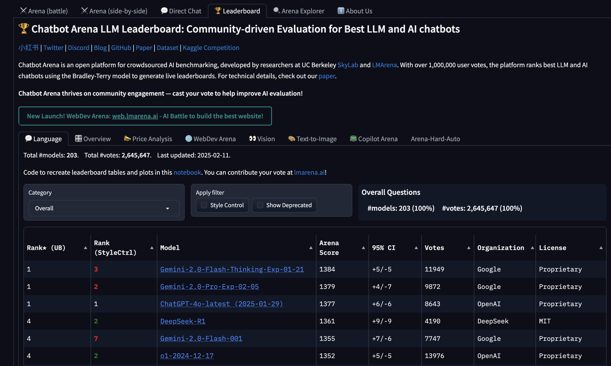
Which LLM is Best?

